Slide 1
A1: Needfinding for Mental Health
Kristine Ma, Carolyn Lee, Lucas Wang, Evelyn Song
CS147 ✳ Fall 2024

Slide 2
Table of contents
01
02
03
04
Introduction
Needfinding Methodology
Team intros and choosing a project domain
Choosing participants, questions asked, user variety
Interview Results
Conclusions
Key quotes, takeaways, insights / empathy maps
What’s next?

Slide 3
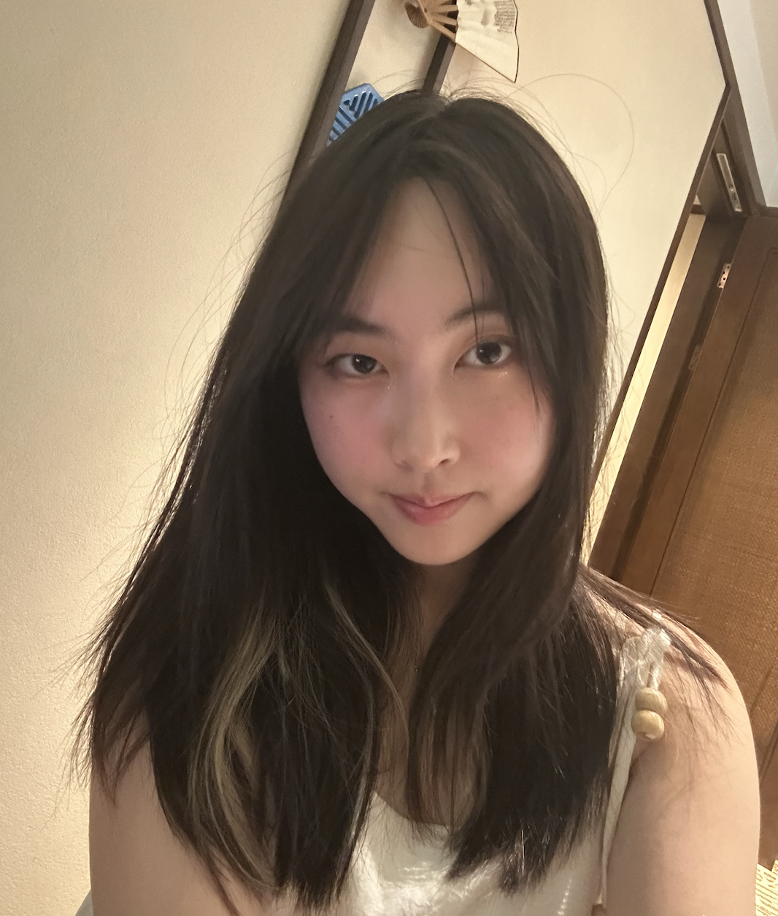
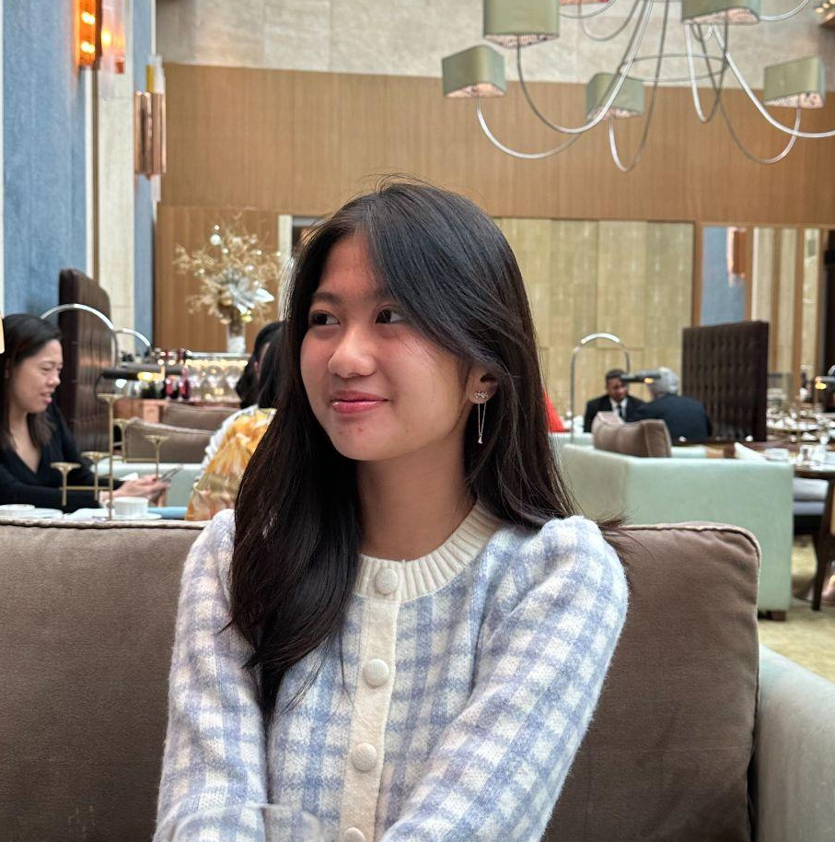
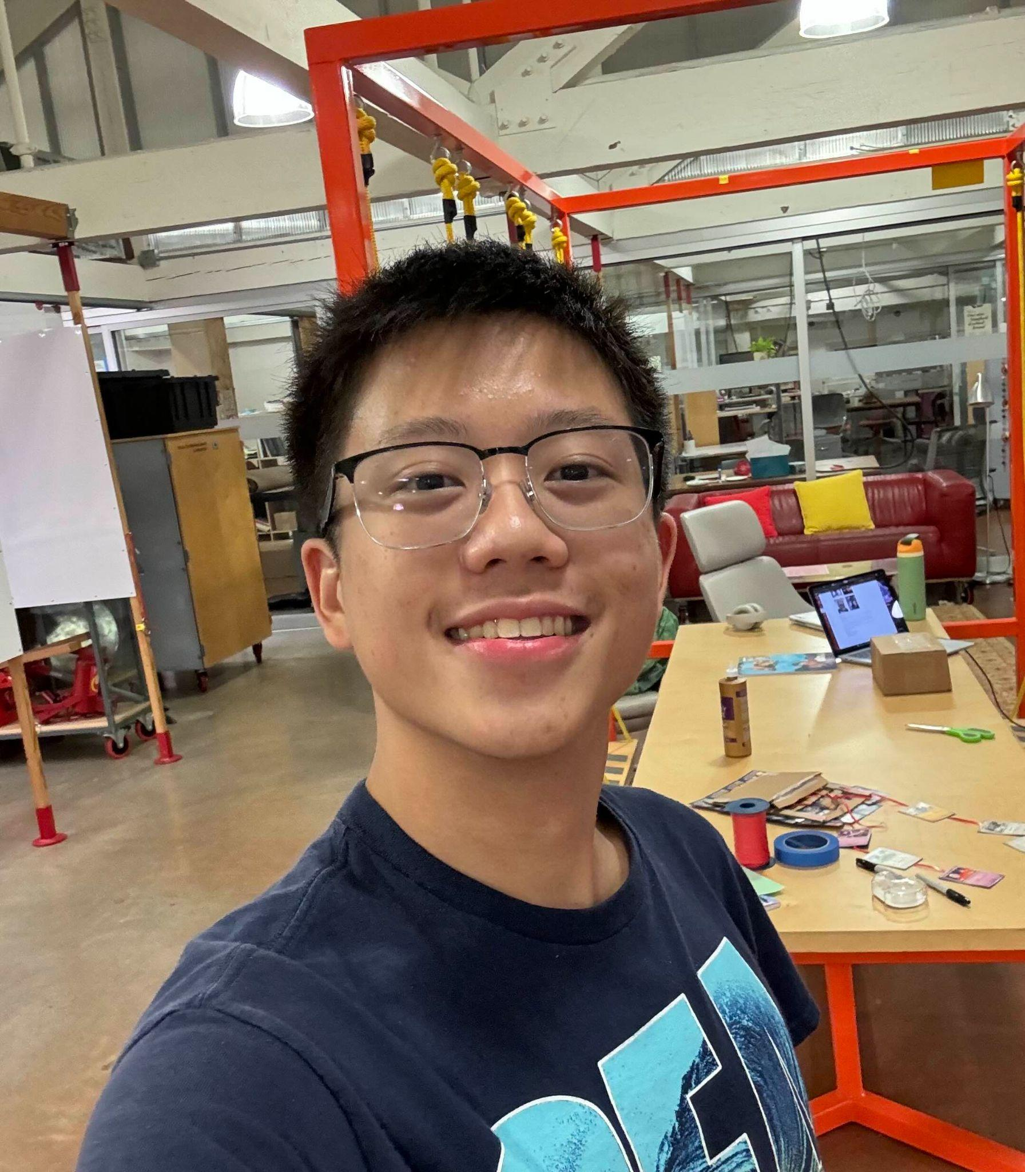
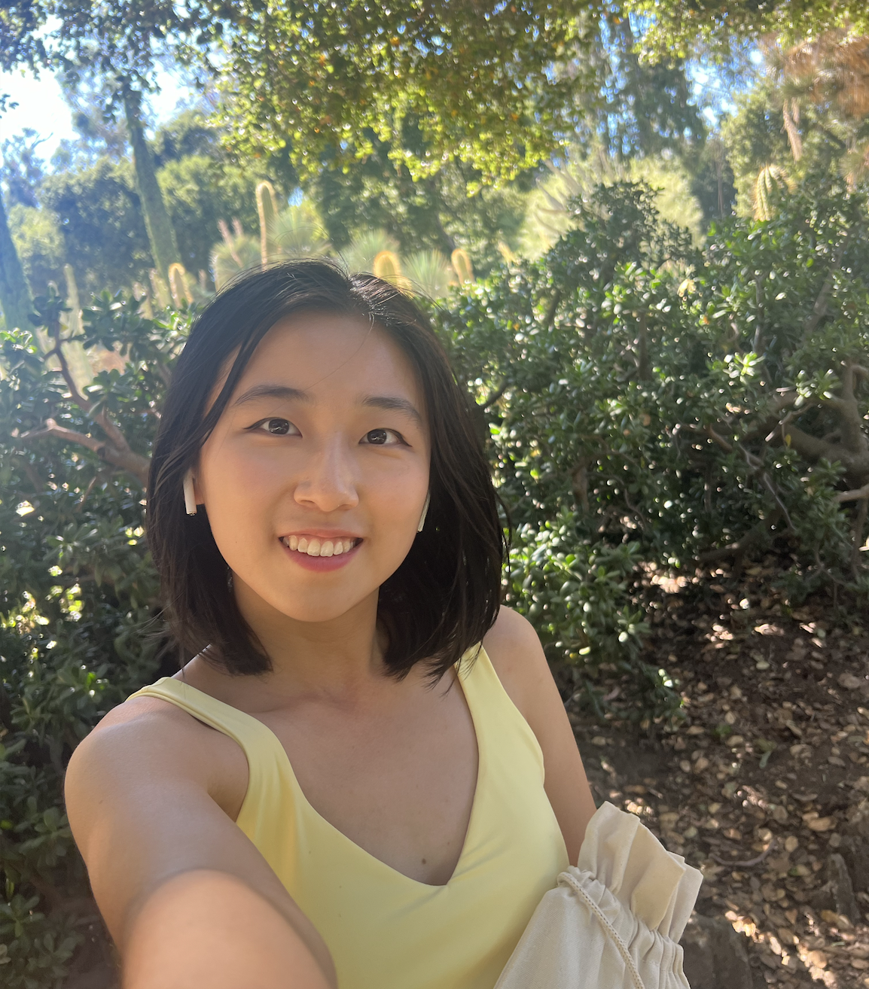
Meet the team!
Kristine Ma
Carolyn Lee
Lucas Wang
Evelyn Song
Junior
Symbolic Systems (HCI)
Junior
Computer Science (HCI)
Sophomore
Design +
CS (HCI)
Junior
Human Biology + CS (HCI)

Slide 4
Choosing a Project Domain
University Setting
Choosing a domain that can help students’ mental health
Shared Interests
Burnout & Stress
Student identity + shared stressors of university life (ECs, classes, work)
Concerns that we’ve generally observed in college students

Slide 5
Interviewee Criteria
Background
Non-overlapping identities, varied universities
University Students
Mental Health
Current or recently graduated students
Some history with mental health / ongoing struggles

Slide 6
Key Questions
What role does social support (friends, family, peers) play in your mental health during your time at college?
How do you typically cope with stress during the semester?
Tell me about your life both academically and socially.
Have you found any resources that you’ve found helpful/unhelpful in managing your mental health?
Have you ever explored mental health services or resources provided by your college?
What are the biggest problems you face in maintaining your mental health in college?
Can you describe a time when you felt overwhelmed by the demands of college life? What contributed to that experience?
How does stress affect your overall mental and physical well-being?

Slide 7
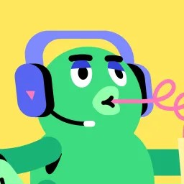

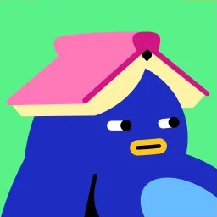
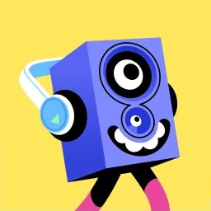
Interviewee Profiles
Carl S.
Will H.
Alex C.
Grace J.
Sophomore at Diablo Valley College
UCLA Graduate (‘22),
SWE @ Google
Junior at the University of Michigan
Junior at the University of Pennsylvania
*Names changed for anonymity*

Slide 8

Carl S.
Chosen because of expressed frustration / stress in a public server
Unique background as a FLI student @ a community college
Conducted interview in-person on Stanford campus
Notes:
Participants: Why were they chosen? Why are they appropriate? How were they recruited/compensated? b. Where were the interviews conducted? c. Who was your “extreme user”? In what axis are they extreme? d. What did you ask? e. Team member roles for each interview f. Apparatus – any equipment/software used (transcribing, etc.)

Slide 9
Carl S: FLI & Lost
“If I went to a normal college, things would be set up properly [for me], things would probably be smoother than what I have been experiencing.”
“It has a bit of a depressing feeling— I just keep telling myself, it’s not the end of the world.”
“I don’t know where to go - I feel like [the counselors] are clueless.”

Slide 10
Carl S: FLI & Lost
Main Issues
frustration
Almost failed classes due to stress, placed on “academic alert”
Couldn’t go to family because of FLI background
Course design makes it almost impossible to transfer
Classes are all online
Unorganized deadlines, no information— missed FAFSA
stress
Key Insights
Friends are his main source of support
Online classes— what about his support system at college?
Need for more organization, but doesn’t want “another calendar”
Stays away from mental health resources because they seem “too good to be true”
lonely

Slide 11
Will H.
Chosen because of experiences with mental health & complete college experience
Recent graduate from UCLA, current employee @ Google
Conducted interview at cafe in the Bay Area
Notes:
Participants: Why were they chosen? Why are they appropriate? How were they recruited/compensated? b. Where were the interviews conducted? c. Who was your “extreme user”? In what axis are they extreme? d. What did you ask? e. Team member roles for each interview f. Apparatus – any equipment/software used (transcribing, etc.)

Slide 12
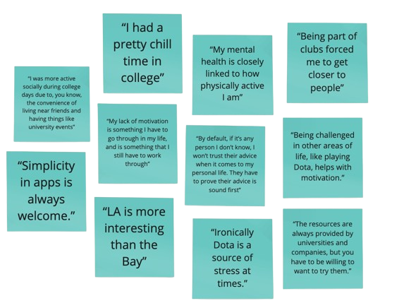
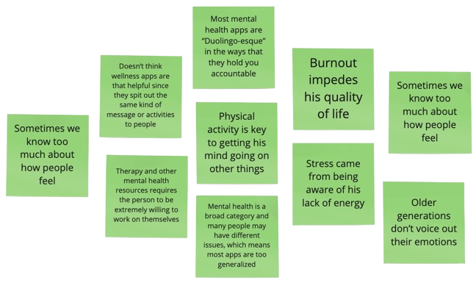
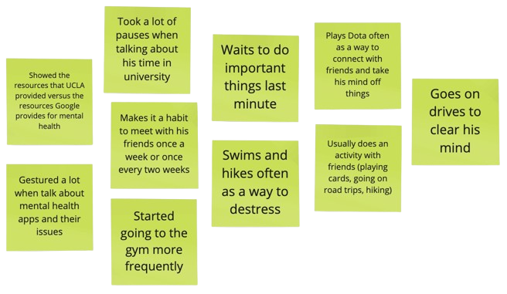
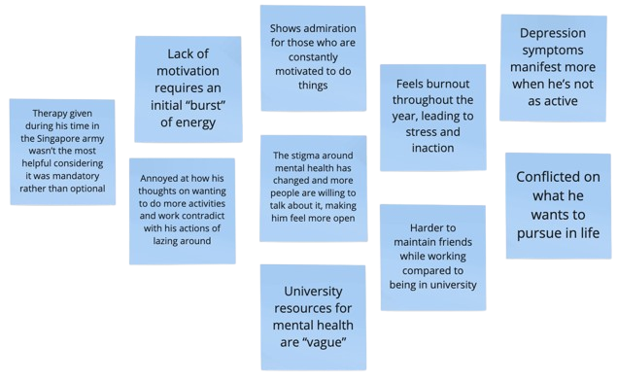
Says
Thinks
Does
Feels

Slide 13
Will H: Mandated Therapy
(Extreme User)
“My lack of motivation is something I have to go through in my life, and is something that I still have to work through.”
“By default, if it’s any person I don’t know, I won’t trust their advice when it comes to my personal life. They have to prove their advice is sound first.”
“My mental health is closely linked to how physically active I am.”

Slide 14
Will H: Mandated Therapy
(Extreme User)
Main Issues
burnout
Not very stressed in college, but struggled with motivation
Distrust of mental health resources
Desire to engage in activities conflicts with “lazing around”
unmotivated
Key Insights
Main struggle is with burnout
Mental health tied to physical activity
Doesn’t trust mental health apps, and points out that university resources are “vague” and are always offered but students have to be willing to try them
skeptical

Slide 15
Alex C.
Chosen because of previous mental health struggles
“Average user” & not very open about personal life
Conducted interview through Zoom
Notes:
Participants: Why were they chosen? Why are they appropriate? How were they recruited/compensated? b. Where were the interviews conducted? c. Who was your “extreme user”? In what axis are they extreme? d. What did you ask? e. Team member roles for each interview f. Apparatus – any equipment/software used (transcribing, etc.)

Slide 16
Alex C: A Closed Book
“That’s a tough question. It’s all, like, internal. Mental health is tough. It’s not like, ‘I have school, so I’m sad.’”
“I thought I was going to be doing a lot more in college— joining clubs, making new friends.”
“All of [my problems] come back to my laziness.”
“I’ll probably struggle to answer anything mental health related anyway.”

Slide 17
Alex C: A Closed Book
Main Issues
unmotivated
Procrastination, stress / workload before due dates
Unmotivated & “lazy” to do things (e.g. cook for himself)
Generally overwhelmed with schoolwork
closed-off
Key Insights
Closed up when talking about mental health, dry responses and more uncomfortable
Heavily reliant on friend group as a support system but doesn’t talk to them much about issues
Didn’t know about university resources, and expressed unwillingness to try them
Emphasized difference between destressing vs. ideal way to spend free time
unwilling

Slide 18
Grace J.
International student with heavy workload
Depression & anxiety disorders as a frosh
Conducted interview at Stanford
Notes:
Participants: Why were they chosen? Why are they appropriate? How were they recruited/compensated? b. Where were the interviews conducted? c. Who was your “extreme user”? In what axis are they extreme? d. What did you ask? e. Team member roles for each interview f. Apparatus – any equipment/software used (transcribing, etc.)

Slide 19
Grace J: Overseas & Overwhelmed
“I cried a lot when I was a freshman. As an international student, there were so many things I had to learn, especially social cues, and it took me a lot of time to adjust.”
“I felt like I was on the edge of failing."
“It’s really good for my mental health because I get to see the kids and feel like I’m helping myself, too.”
“Right now, my mental health is great—I don’t have long-term issues. But sometimes, little things can break me, especially interpersonal stuff.”

Slide 20
Grace J: Overseas & Overwhelmed
Main Issues
unsupported
Difficult to adjust as an international student, different social cues and jokes
Generally stressed about workload
Recovery during surgery— some professors unsupportive
lost
Key Insights
Rough transition into college as an international student
Found it difficult to make friends at first, and still wishes she had more
Feels fulfilled by TA-ing, involved in many extracurriculars
Overall, currently good mental health
logical

Slide 21
Key Takeaways
1.
2.
3.
Unwillingness to
use resources
❎
Social aspect
🫂
Common stressors
💙

Slide 22
What’s next?
1.
2.
3.
HMW, POV statements, and contradictions
💡
Specific interviews
🗣️
Research & usage
🥼

Slide 23
Appendix

Slide 24
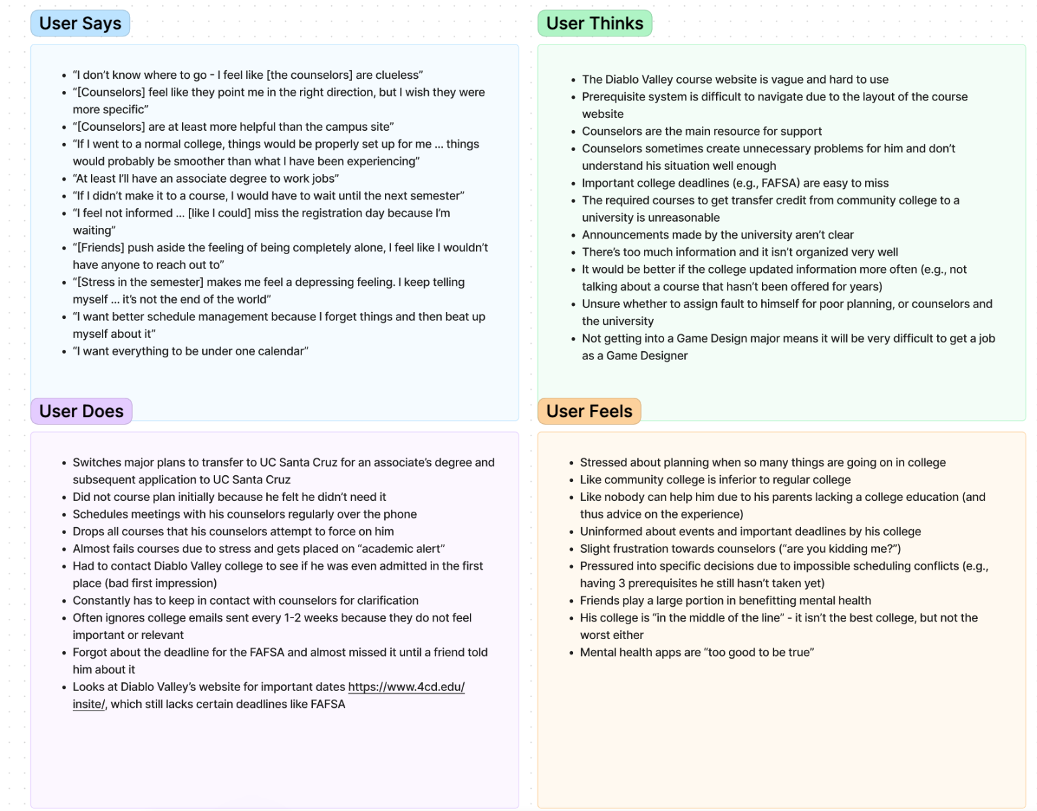
Carl S. — empathy map

Slide 25
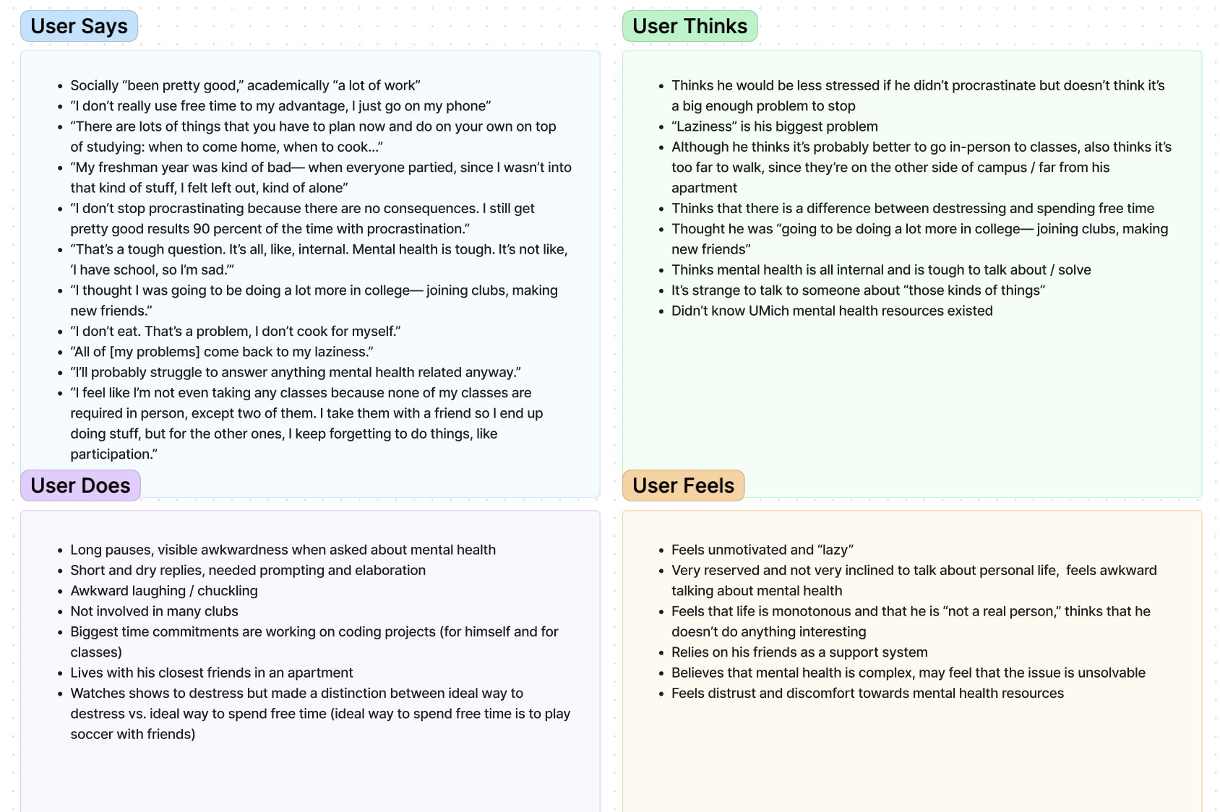
Alex C. — empathy map

Slide 26
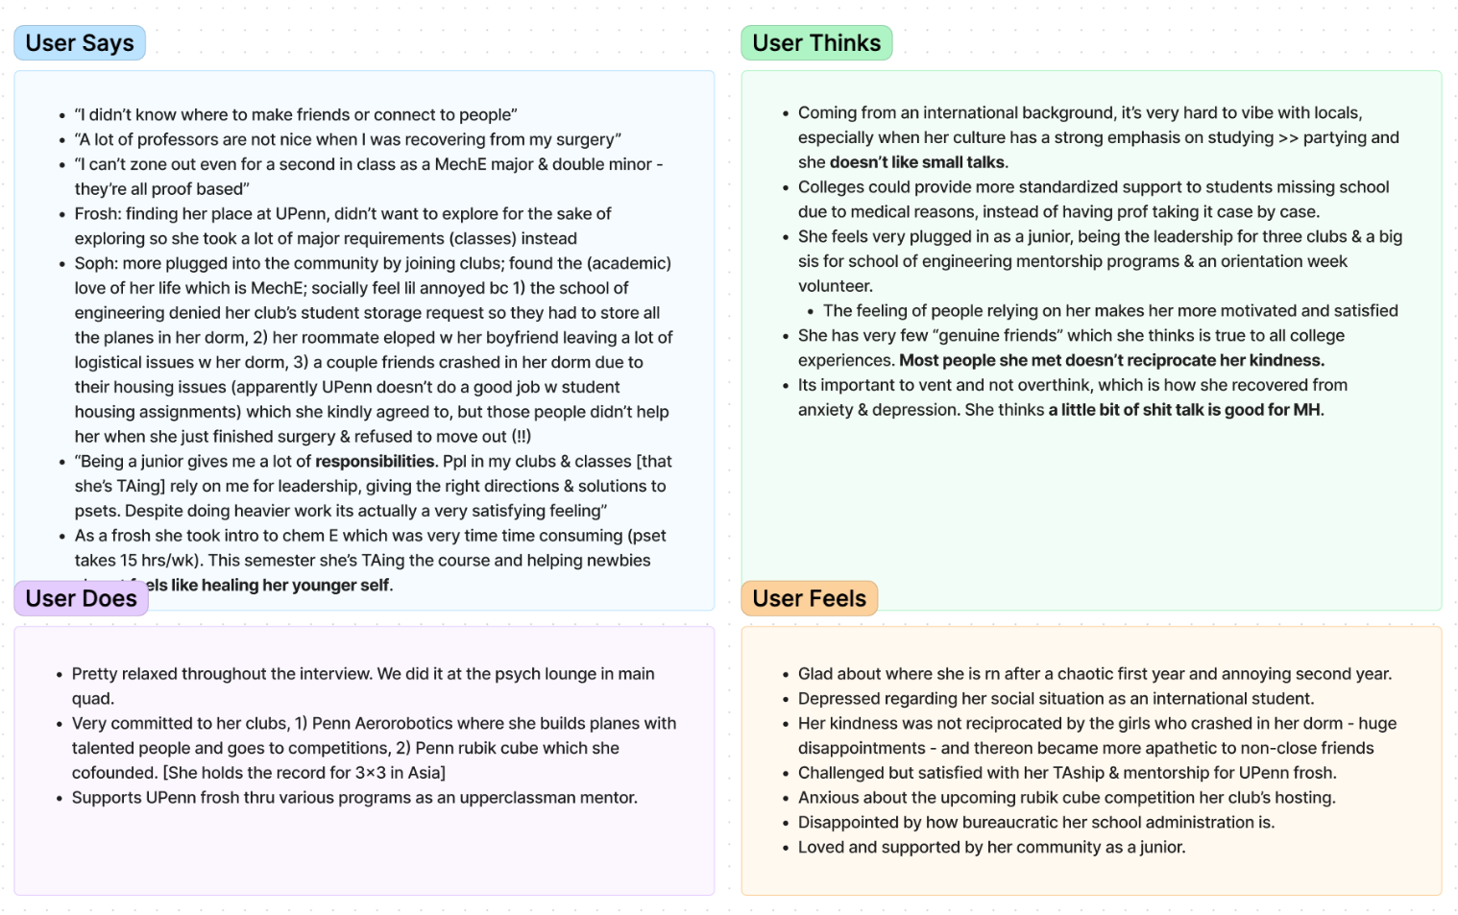
Grace J. — empathy map

